Slide 1
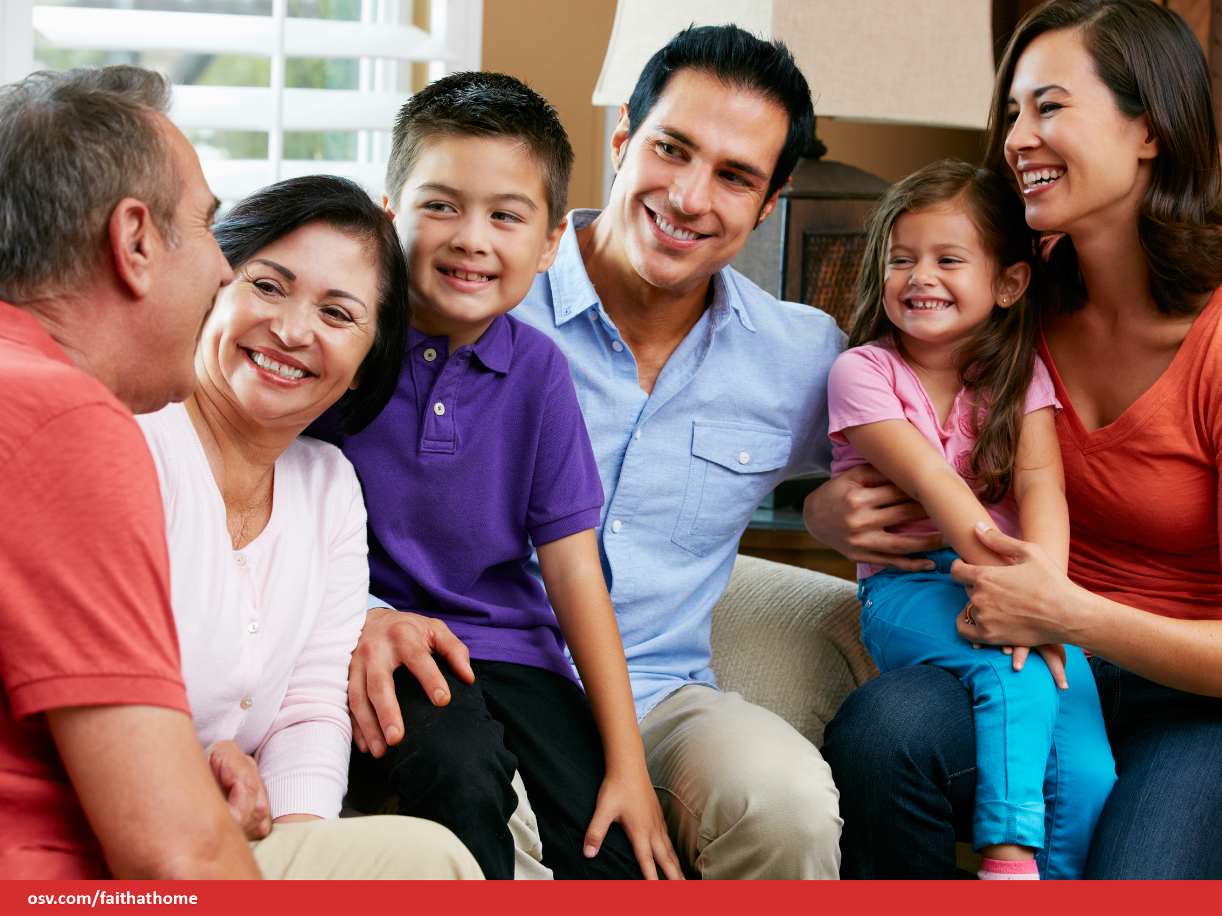
Unit 1 Revelation
How does God communicate with us?
Notes:
Say: Welcome Domestic Church! Yes that’s correct. Each and every one of your homes is a Domestic Church. Our session together are designed to help you all grow in faith and live your lives as Catholics. Today’s session, Unit 1 Revelation, will introduce you to this unit’s theme using the same process that is presented in your child’s Alive in Christ Book: Invite-Discover-Live (three-step catechetical process) Starting with an invitation into God’s Word, we will then discover what the Catholic Church teaches about God’s Revelation so we can Live a life that reflects our faith. In today’s session you will experience an example of each of the three steps.
This information will serve as a briefing for you as you work with your children to explore how we live this faith in everyday life. (Remember that there are 3 Chapters in each Unit)

Slide 2
Invite
We are now going to experience a different kind of praying. It is actually an ancient form of praying called Lectio Divina
(Latin for divine reading)
Notes:
Each time we gather for a session, we will begin by reflecting on God’s Word.
In every chapter you and your children will begin each lesson this way. (INVITE page)They will hear the Word of God, reflect on it, and open their hearts and minds to how God is speaking to them in this reading of Scripture. This reflection process is based on an ancient form of prayer called Lectio Divina. (Latin for divine reading) In it we read/hear the Word of God, listen carefully, and reflect on what God is saying to us.
(Use the picture on the next slide to talk a little bit about the prayer space, discussing the idea of having a family prayer space at home.)

Slide 3
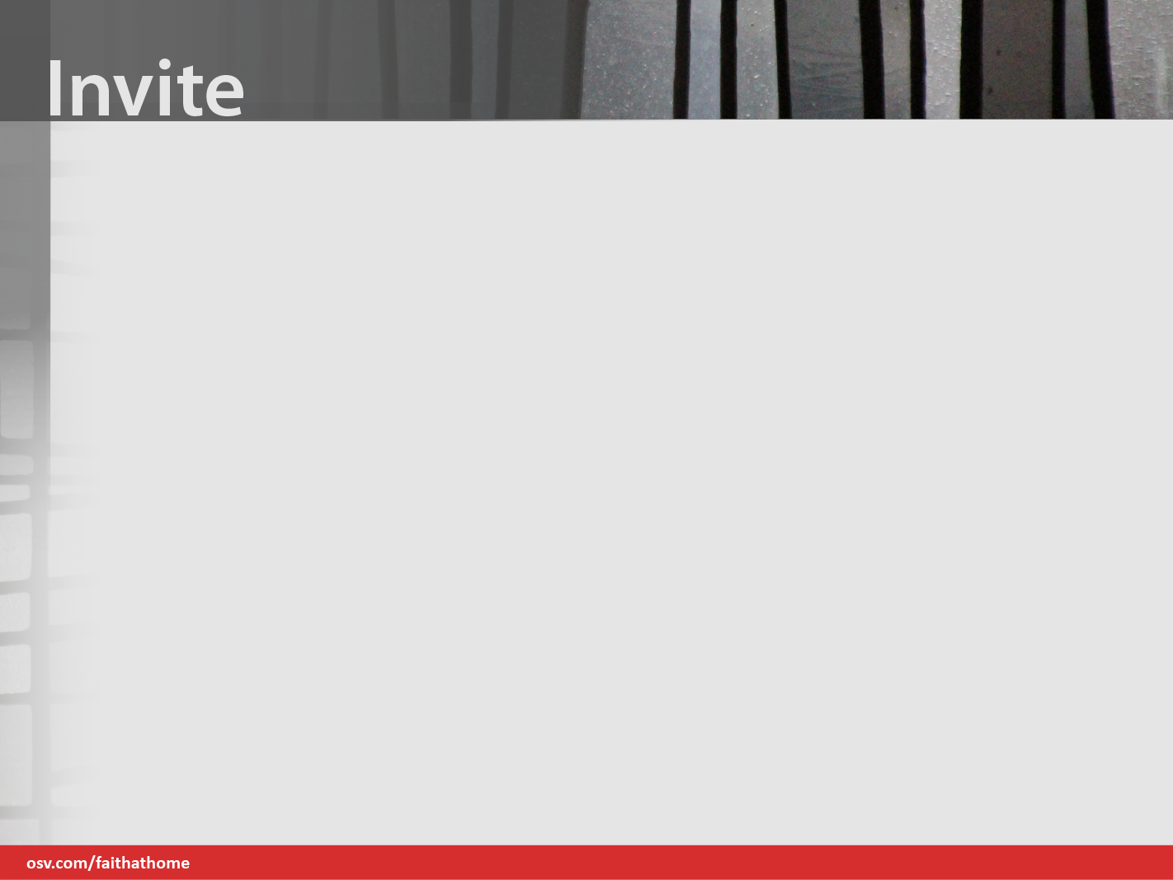
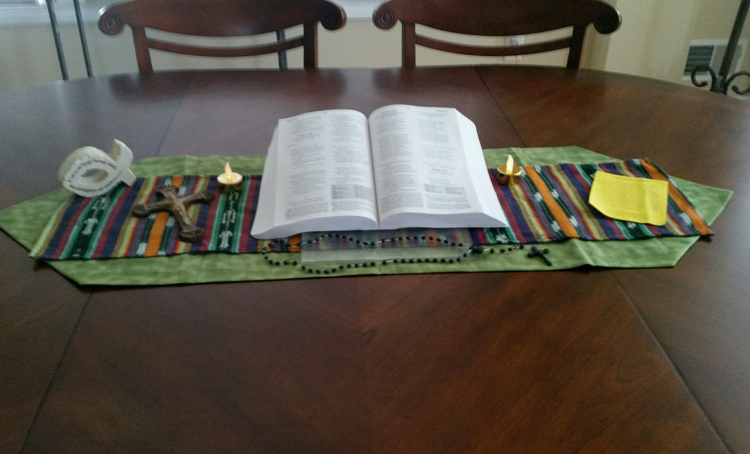
Notes:
Teach families what it means to venerate and why we venerate the Bible. (regard with great respect; revere. )
Suggest to families that in order to keep prayer at the center of what you do in these sessions, you must keep it at the center of your own life.

Slide 4
Encountering God in His Word
I invite you to close your eyes, or to just be still; open your minds and your hearts to
what God is saying to you in this passage.
Listen for: what speaks to you? What one
word or phrase stands out? Why might God be offering that word or phrase to you?
Notes:
Ask the group to settle in their chairs and to take of few deep slow breaths.
Before proclaiming the reading, pause in silence for a few moments.
Proclaim the excerpt from Psalm 139 (Psalm 139:1b-6; 13-18; 23-24).
After the reading pause for a few moments for silent reflection.
Model this for the group.

Slide 5
Excerpt from Psalm 139 (139:1 b-6; 13-18; 23-24)
1 O Lord, you have searched me and know me.
2 You know when I sit down and when I rise up;
you discern my thoughts from far away.
3 You search out my path and my lying down,
and are acquainted with all my ways.
4 Even before a word is on my tongue,
O Lord, you know it completely.
5 You hem me in, behind and before,
and lay your hand upon me.
6 Such knowledge is too wonderful for me;
it is so high that I cannot attain it.
Notes:
1 O Lord, you have searched me and known me.
2 You know when I sit down and when I rise up;
you discern my thoughts from far away.
3 You search out my path and my lying down,
and are acquainted with all my ways.
4 Even before a word is on my tongue,
O Lord, you know it completely.
5 You hem me in, behind and before,
and lay your hand upon me.
6 Such knowledge is too wonderful for me;
it is so high that I cannot attain it.

Slide 6
Excerpt from Psalm 139 (139:1 b-6; 13-18; 23-24)
13 For it was you who formed my inward parts;
you knit me together in my mother’s womb.
14 I praise you, for I am fearfully and wonderfully made.
Wonderful are your works;
that I know very well.
15 My frame was not hidden from you,
when I was being made in secret,
intricately woven in the depths of the earth.
16 Your eyes beheld my unformed substance.
In your book were written
all the days that were formed for me,
when none of them as yet existed.
Notes:
13 For it was you who formed my inward parts;
you knit me together in my mother’s womb.
14 I praise you, for I am fearfully and wonderfully made.
Wonderful are your works;
that I know very well.
15 My frame was not hidden from you,
when I was being made in secret,
intricately woven in the depths of the earth.
16 Your eyes beheld my unformed substance.
In your book were written
all the days that were formed for me,
when none of them as yet existed.

Slide 7
Excerpt from Psalm 139 (139:1-6; 13-18; 23-24)
17 How weighty to me are your thoughts, O God!
How vast is the sum of them!
18 I try to count them—they are more than the sand;
I come to the end—I am still with you.
23 Search me, O God, and know my heart;
test me and know my thoughts.
24 See if there is any wicked way in me,
and lead me in the way everlasting.
Notes:
17 How weighty to me are your thoughts, O God!
How vast is the sum of them!
18 I try to count them—they are more than the sand;
I come to the end—I am still with you.
23 Search me, O God, and know my heart;
test me and know my thoughts.
24 See if there is any wicked way in me,
and lead me in the way everlasting.

Slide 8
Encountering God in His Word
What word or phrase stood out to you?
Why might this have meaning?
Notes:
Maintain a few moments of silence after the reading is complete. Then break the silence by reading the questions on the slide.
Invite families to take a moment to think and discuss the questions and then write down the word or phrase in their Family + Faith Journal (at this point go back to the scripture slides so participants can see the reading again).
Ask for a volunteer or two to share why that word or phrase has meaning to them. In case there are no volunteers, be prepared with your own word or phrase so you can model the process for the group.

Slide 9
Encountering God in His Word
God always speaks to us. We will hear him if we make the space for him,
we seek him and intentionally listen for him.
Practice this type of prayer at home. Children are generally very open to listening for God in his Word.
Notes:
SUGGESTION:
Encourage families to create their own prayer center at home.
On a table drape fabric (when appropriate, keep with the colors of the liturgical cycle) across the table. Put a Bible on a bookstand in a place of prominence. Adorn the table with candles, and a cross or crucifix… simple and elegant. Possibly create a list of family prayer intentions. [Instructions/suggestions for doing this in your home will be emailed]
Also, this can be a fruitful family practice each weekend. Prior to Mass (maybe Sat. evening), use this process and pray with this Sunday’s readings. This can make the Liturgy of the Word more meaningful for all members of the family.
Now, transition to the Discover Step.

Slide 10
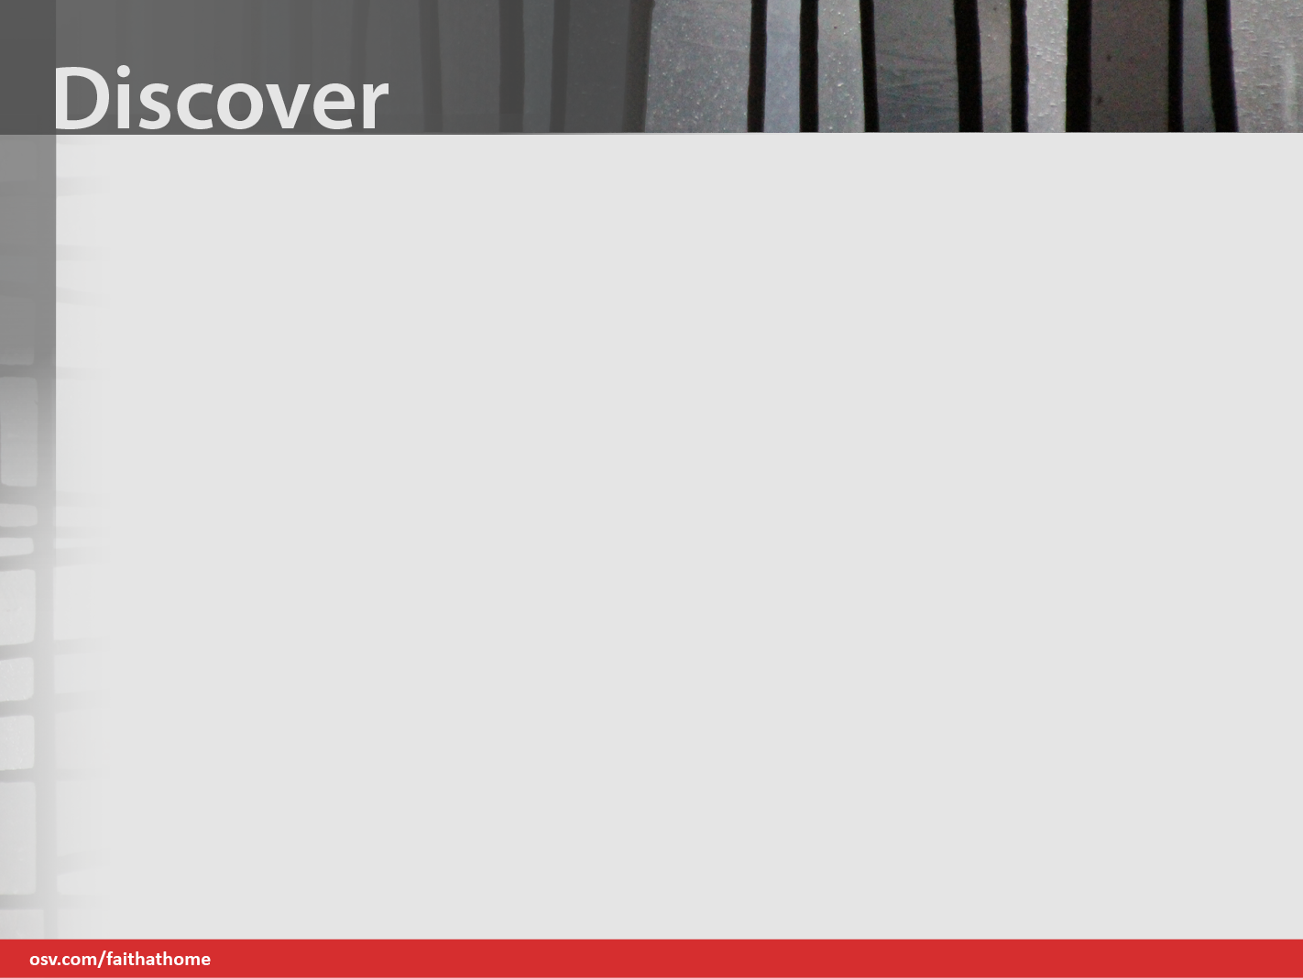
We heard in our prayer that God knows us. He knows everything about us. He knew us before we were born.
We learn that:
God wants us to know him, to be in relationship with him, and to grow closer to him.
Notes:
Say: The Discover Step helps form Catholic Identity through the study of Scripture, knowledge of Church teaching, and an understanding of Catholic practices.

Slide 11
How and when does God communicate with us?
Throughout our lives.
Through creation
Through his Word in Sacred Scripture
Through Sacred Tradition
Most especially, through his Son, Jesus Christ.
Through the many personal and communal experiences we have.
Notes:
God’s communication with us continues throughout our lives. God reveals himself to us through creation, in a unique way in his Word in Sacred Scripture and Sacred Tradition, and most especially through his Son, Jesus Christ. We also come to know God through the many personal and communal experiences we have.

Slide 12
As we continue to respond to God in faith, we grow in a deeper and more intimate relationship with him. Continued study, prayer, and reflection with Scripture help us to understand and apply God’s Word to our lives.
Notes:
As we continue to respond to God in faith, we grow in a deeper and more intimate relationship with him. Continued study, prayer, and reflection with Scripture help us to understand and apply God’s Word to our lives.

Slide 13
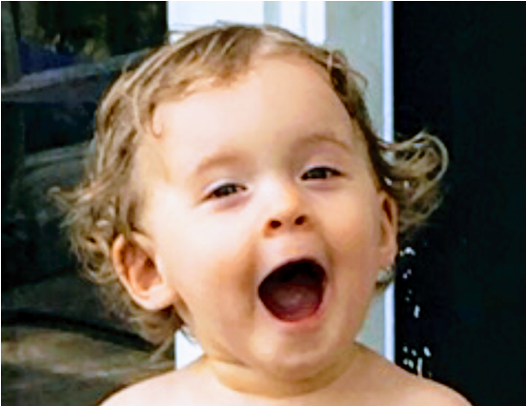
When you hear the word Revelation, you think (fill in the blank)
Expose
Leak
Disclosure
Surprise
Shock
Eye-opener
Announcement
Notes:
Ask families to discuss the question and write down (in their Family + Faith Journals) words or phrases that explain / describe Revelation.
Ask for some response from the group.
Once you’ve had a few responses, click through the list on the slide.

Slide 14
“to reveal” is to make known or communicate. Revelation can be described as something that is revealed, an enlightening or astonishing or surprising disclosure (Merriam Webster).
As Catholics, we define Divine Revelation as the process by which God makes himself known to humans and discloses who he is and his plan for us.
Notes:
“to reveal” is to make known or communicate. Revelation can be described as something that is revealed, an enlightening or astonishing or surprising disclosure (Merriam Webster).
As Catholics, we define Divine Revelation as
the process by which God makes himself known to humans and discloses who he is and his plan for us.

Slide 15

How many of you have been pleasantly surprised by creation?
You looked at a starry night and might have been amazed at how infinite it seemed, how tiny we are.
Or maybe you watched a beautiful sunset and stood in awe of God’s glory. We feel God’s presence in nature.
Notes:
Read slide:
How many of you have been pleasantly surprised by creation? You looked at a starry night, and might have been amazed at how infinite it seemed, how tiny we are. Or maybe you watched a beautiful sunset and stood in awe of God’s glory. We feel God’s presence in nature.

Slide 16

Notes:
Say nothing, just leave slide up for about 15 seconds

Slide 17
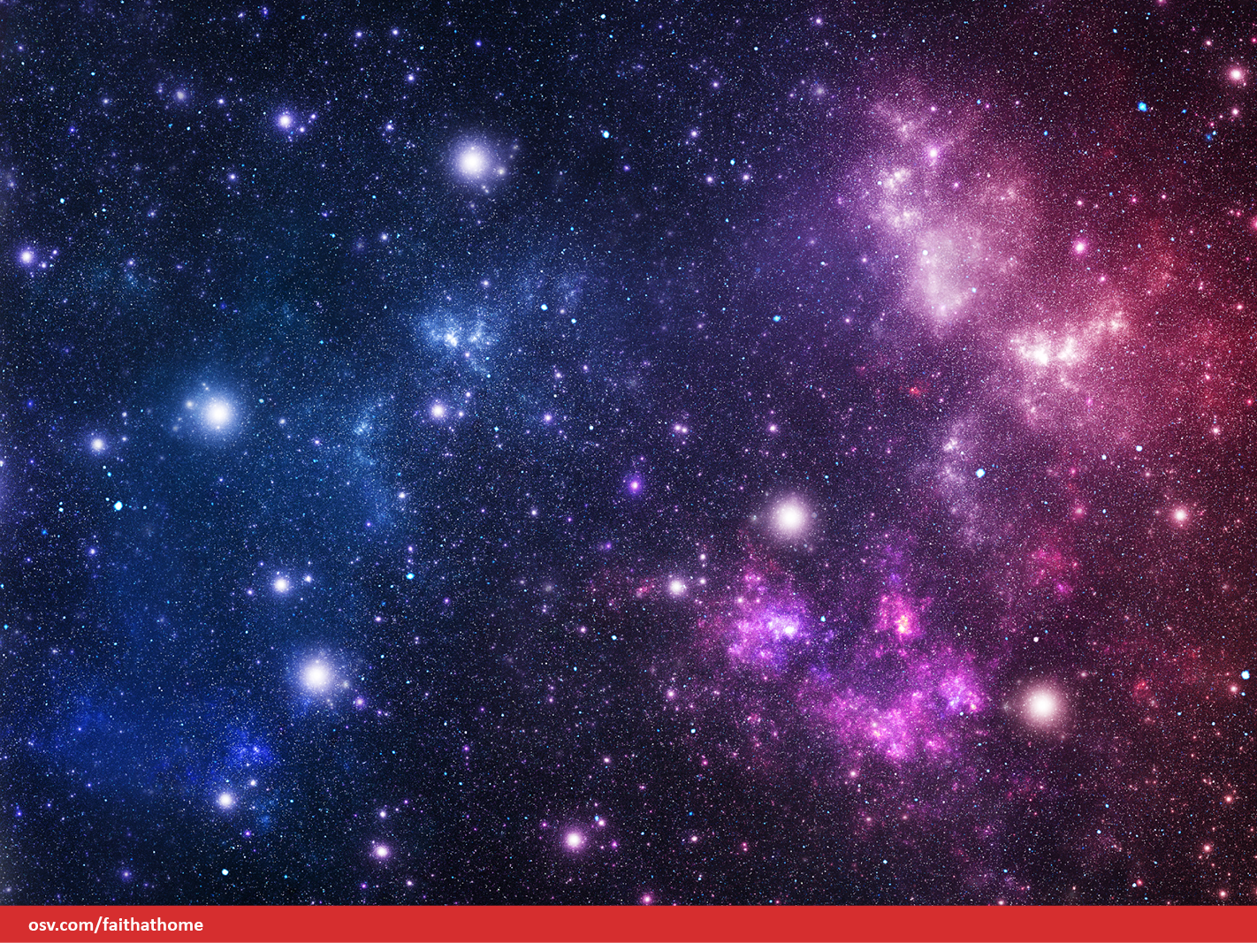
Notes:
Say nothing, just leave slide up for about 15 seconds

Slide 18
You might remember that feeling of holding your newborn infant and wondering how this beautiful creature could be created from the love you share, and especially the feeling of surprise at how you could love this child more than you ever imagined.
Notes:
Read Slide:
You might remember that feeling of holding your newborn infant wondering how this beautiful creature could be created from the love you share, and especially the feeling of surprise at how you could love this child more than you ever imagined.

Slide 19
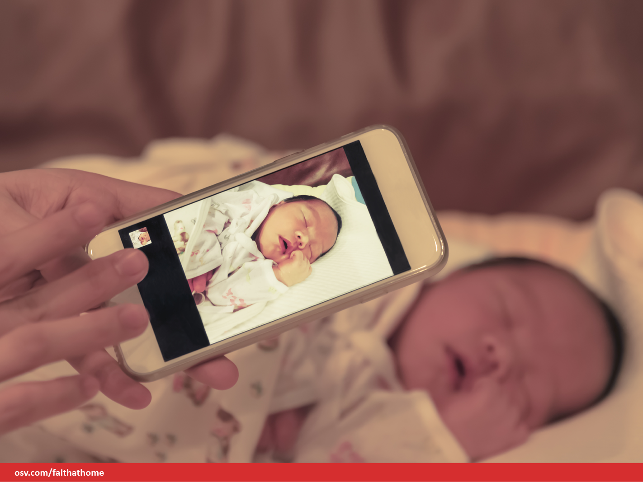
Notes:
Say nothing, just leave slide up for about 15 seconds

Slide 20
These are beautiful experiences that enlighten us. We learn something about ourselves, but even more importantly, we learn about our Creator.
We feel a part of something bigger than ourselves. Wonder and awe come together and reveal to us the mystery of God and of being part of his creation.
Notes:
Read slide:
These are beautiful experiences that enlighten us. We learn something about ourselves, but even more importantly, we learn about our Creator.
We feel a part of something bigger than ourselves. Wonder and awe come together and reveal to us the mystery of God and of being part of his creation.

Slide 21
God's Creation
Notes:
Play Video

Slide 22
So how do we know God?
How does he reveal himself to us?
God reveals himself to us through creation, of course. When we spend time outside in nature, we are reminded of all that God created.
Notes:
So how do we know God? How does he reveal himself to us? God reveals himself to us through creation, of course. When we spend time outside in nature we are reminded of all that God created.
Suggest families plan a nature walk to carefully look for signs of God’s Creation. Bring your Family + Faith Journal and take some notes.

Slide 23
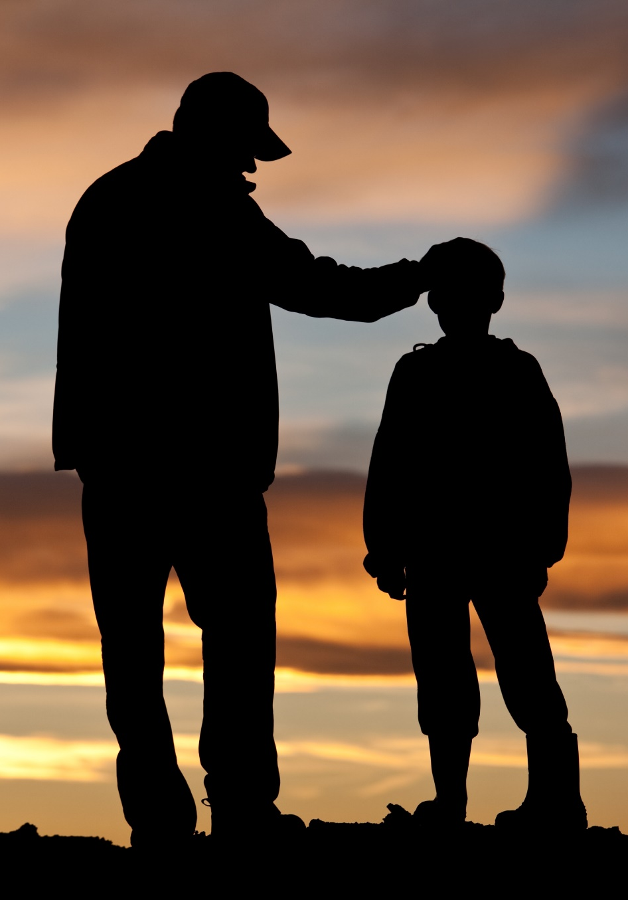
Most of us also come
to know God through
the people in our lives. Through our relationships, with our parents, our children, our friends and family, our priests and spiritual companions,
our godparents and Confirmation sponsors, we come to know the
love of God.
Notes:
Most of us also come to know God through the people in our lives.
Through our relationships, with our parents, our children, our friends and family, our priests and spiritual companions, our godparents and Confirmation sponsors, we come to know the love of God.

Slide 24
Who teaches you about God?
Who shows you who God is?
How else do we learn about God?
How can we get to know him better?
We will learn that God reveals himself to us through:
Sacred Scripture Sacred Tradition and especially through his Son, Jesus Christ.
The Bible, Sacred Scripture, is the inspired Word of God written in human words.
Notes:
Who teaches you about God? Who shows you who God is? How else do we learn about God? How can we get to know him better?
We will learn that God reveals himself to us through:
Sacred Scripture, Sacred Tradition, and especially through his Son, Jesus Christ. The Bible, Sacred Scripture, is the inspired Word of God written in human words.

Slide 25

Questions to Ponder
How do I know God?
Where do I most feel God’s presence?
How have I come to know who God is?
Through nature?
Through Scripture?
Through people?
When was the last time I experienced the awe of God and his work?
Notes:
Ask participants to discuss and write down answers in their Family + Faith Journal
Assure them they don’t need to go deep here, sharing specific experiences, unless they feel led by the Spirit to do so.
Allow a few minutes.
Ask if anyone would like to share an answer.

Slide 26
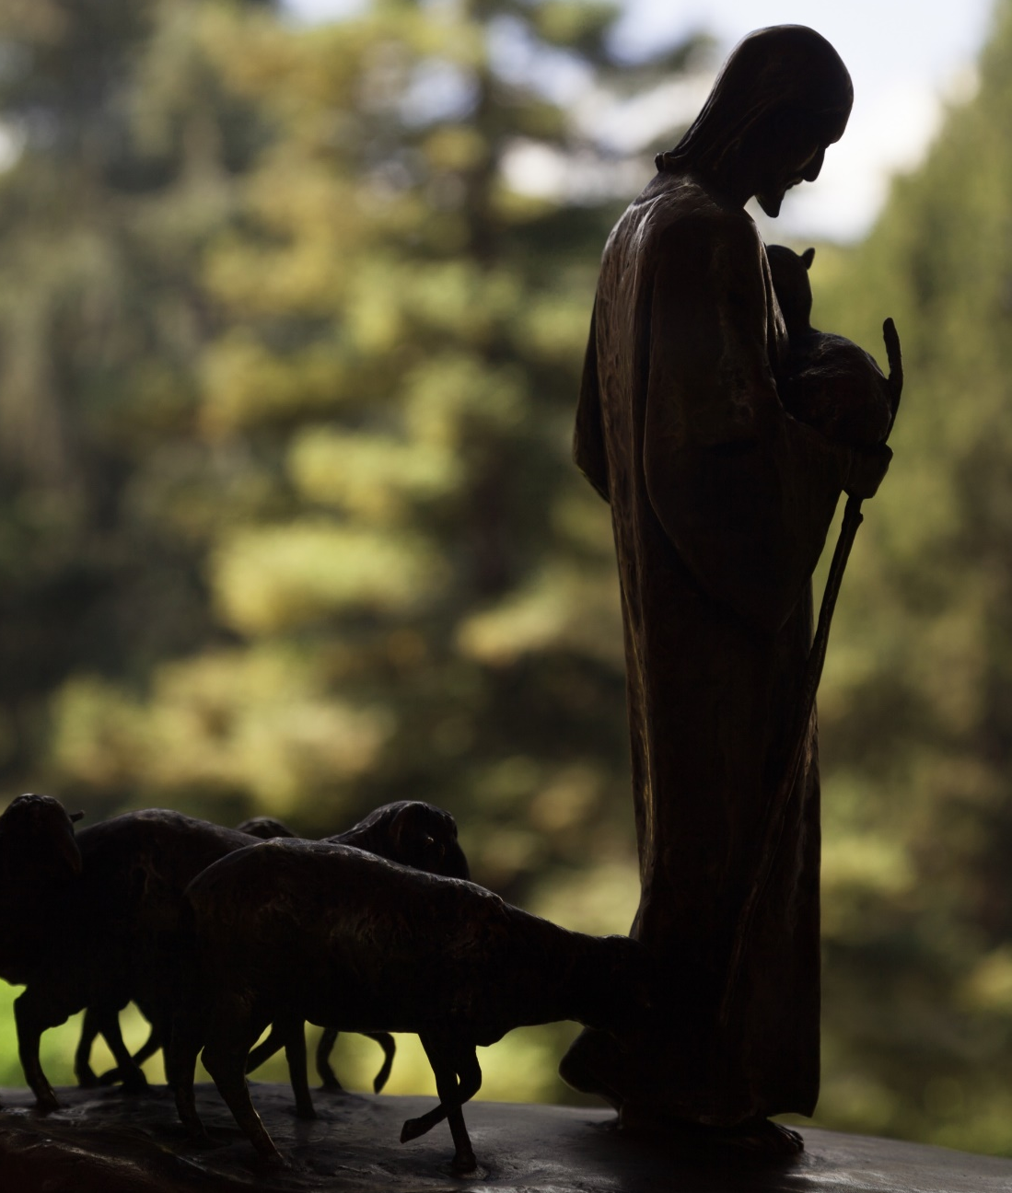
We’ve explored a few of the ways that we get to know God, but the Church teaches us that we know God most especially through His Son, Jesus Christ.
Notes:
The Catholic Church teaches us the story of our faith—the story of God and his plan for our salvation, through his Son, Jesus Christ. We find this plan in Scripture, but we also see the images of this plan in our churches, in stained glass windows, in the Stations of the Cross, in statues, in the image of the Crucifixion, in icons, and in our baptismal fonts. The Church keeps and protects this Tradition and ensures our correct understanding of this teaching of salvation.

Slide 27
It is in our knowledge of his life, Passion, Death, and Resurrection, that we know God’s plan for each of us and for our salvation.
What did Jesus teach?
Who was this man who was both human and divine?
Notes:
This correct understanding comes from Scripture and from oral tradition, the oral teachings Jesus gave his Apostles, who handed them down to us through his Church. We are all called to know God. But I have to ask myself, we have to ask ourselves: How do I know God? How do I develop a relationship with him?

Slide 28
He showed us who the Father is, and then told everyone who would come to believe, to go out and “make disciples.”
We are commanded to share our own faith and to help others come to know God.
Notes:
When you forgive one another, you teach your children to forgive. When you teach your children to apologize to one another or to you for wrong choices, you are teaching them the value of confession and forgiveness.
When you listen after your spouse has had a long day, or when your child comes home from a bad day at school, you heal one another. Whether it’s Band-Aids on scraped knees or a hug after fallen tears—you help them heal.
And you pray for your children. You pray for your loved ones. Even the most hardened heart still cries out to God in prayer when our loved ones are in need. Let your children know you pray for them. Teach them to pray.
In all these ways you reveal God to your family, to your children. It is in the family that we learn love. Our faith formation team (our parish staff/faith community) is aware of the challenges parents face in the daily tasks of living. To teach children that faith education has a primary place in our lives is not easy amidst our busy schedules, yet it is so very important, so absolutely necessary. This is how we “go out and make disciples”.

Slide 29
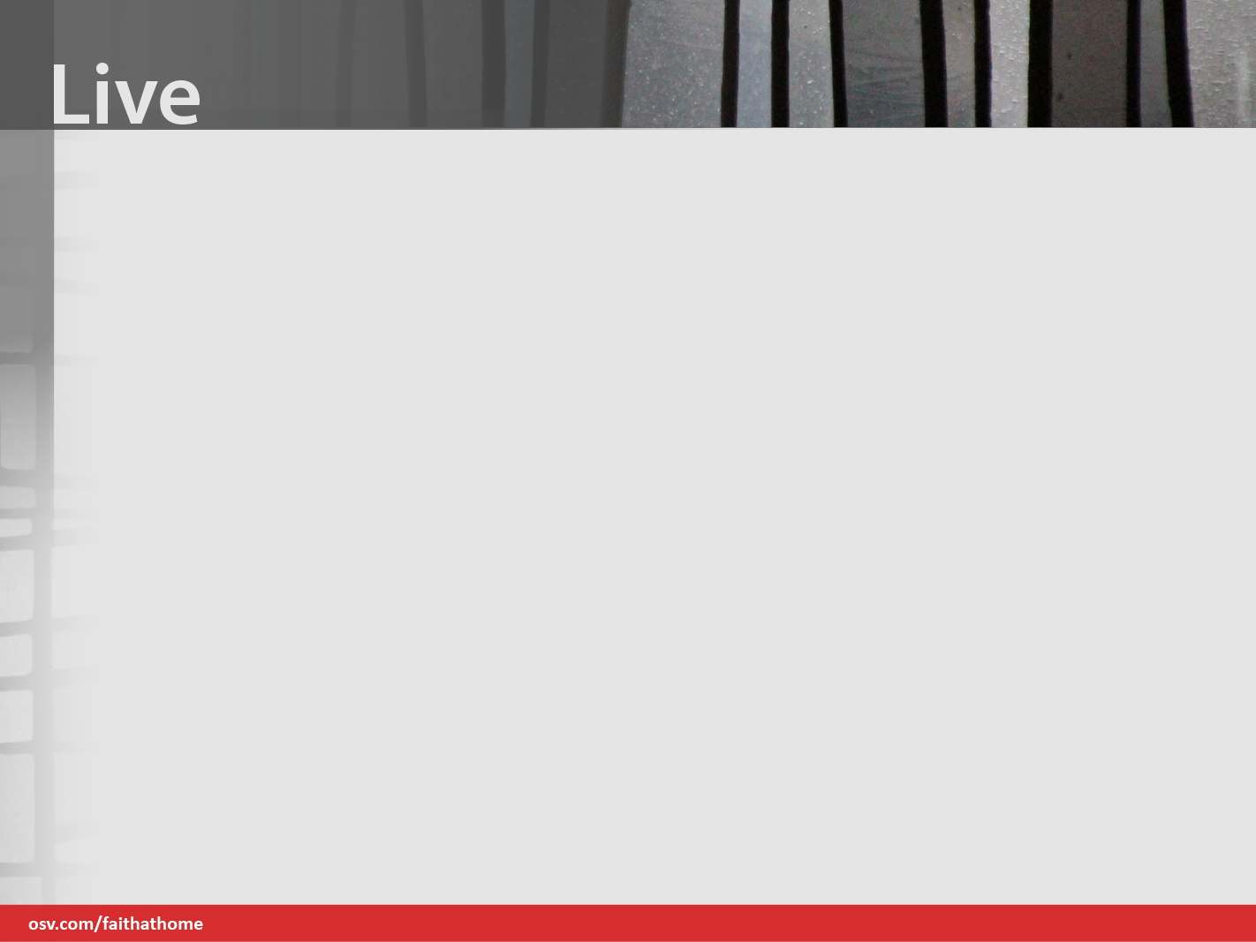
The Live Step helps us relate knowledge of the faith and ways we worship, live, pray, and serve together as Catholics.
We are given the tools to connect faith to everyday life and to deepen their relationship with God and the Church through the prayer experience at the end of each lesson.
Notes:
(ORIENTATION SLIDE) As we mentioned earlier, your child’s book follows the same catechetical process (Invite-Discover-Live) for every chapter. For today’s session we will conclude by sending
Family + Faith Parent Pages to you via email.

Slide 30
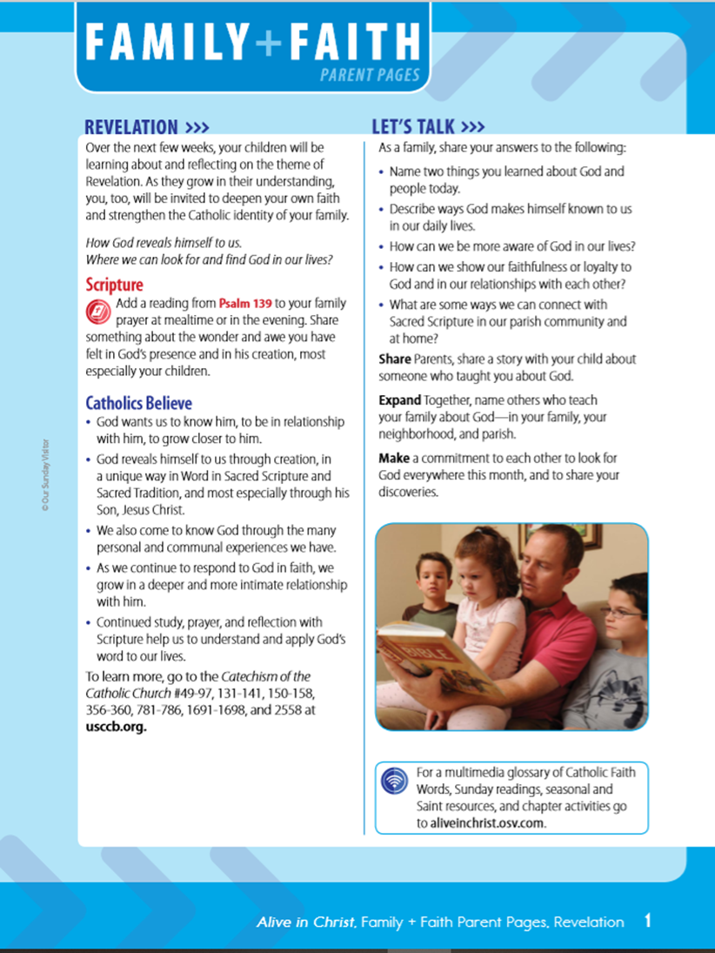
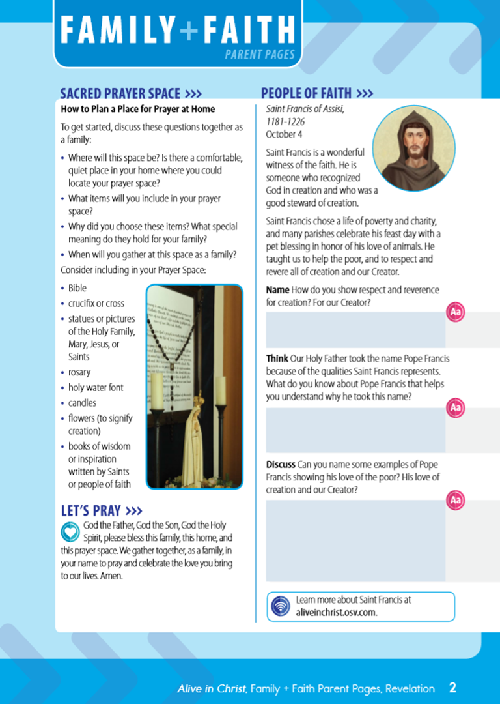
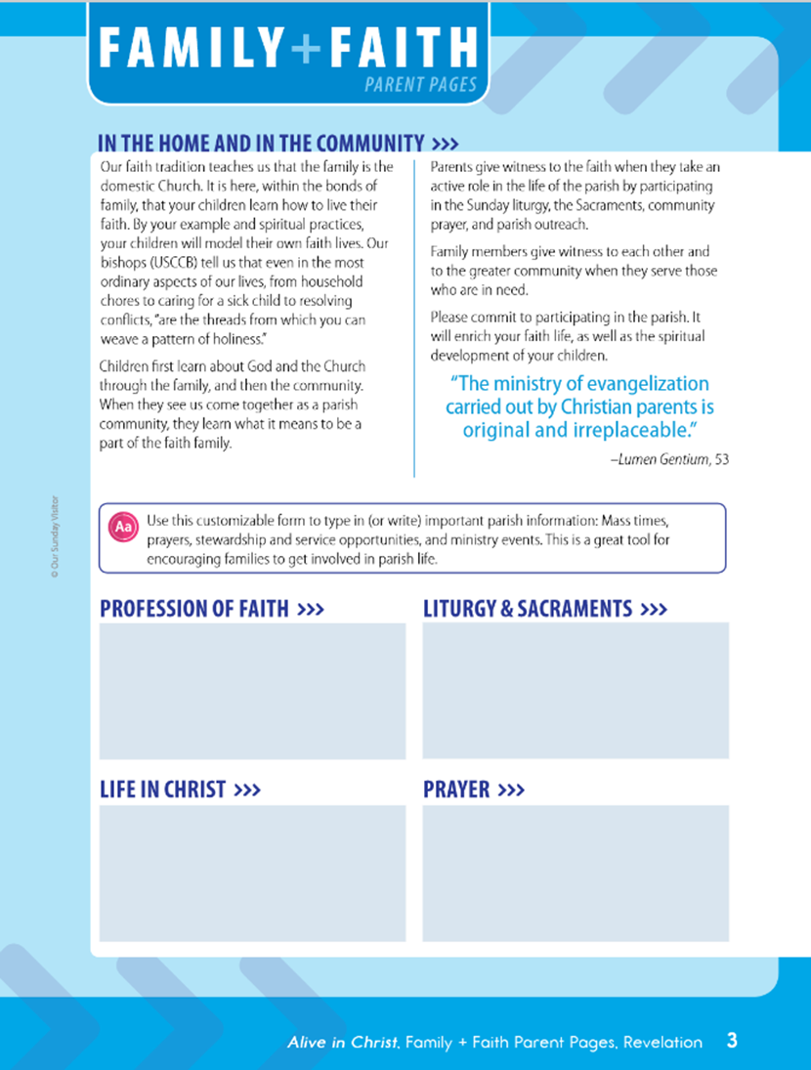
Family + Faith Parent Pages have been created so that as a family you can review the topic and implement practices in order to transform your lives.
Notes:
These pages will provide information and activities that will enable families to complete the Live step for Unit 1 Revelation.

Slide 31
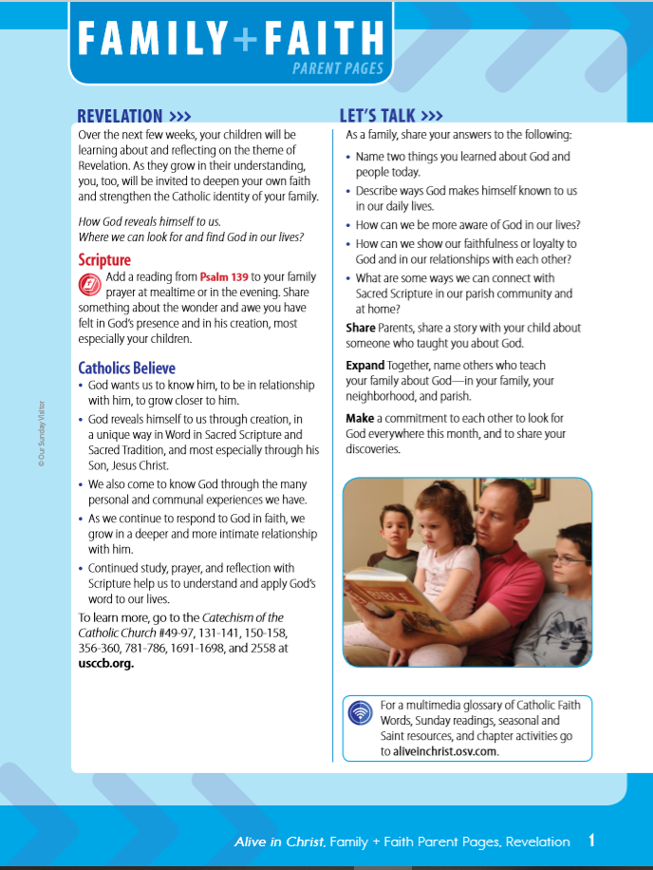
Topic Description
Conversation Starters
Scripture Proclaimed
Family Faith Commitments
What Catholics Believe About this Topic
Online Resources
Notes:
Review Key Features of the Family + Faith Parent Pages:
- Revelation Description
- Scripture Proclaimed
- What Catholics Believe About Revelation
- Let’s Talk Conversation Starters
-Family Faith Commitments
- Online Resources

Slide 32

Family Activity
Role Models:
Saints, Blesseds & Venerables
Family Prayer
Notes:
Review Key Features of the Family + Faith Parent Pages:
- Sacred Prayer Space Family Activity
- A Family Prayer
- People of Faith,
St Francis of Assisi

Slide 33
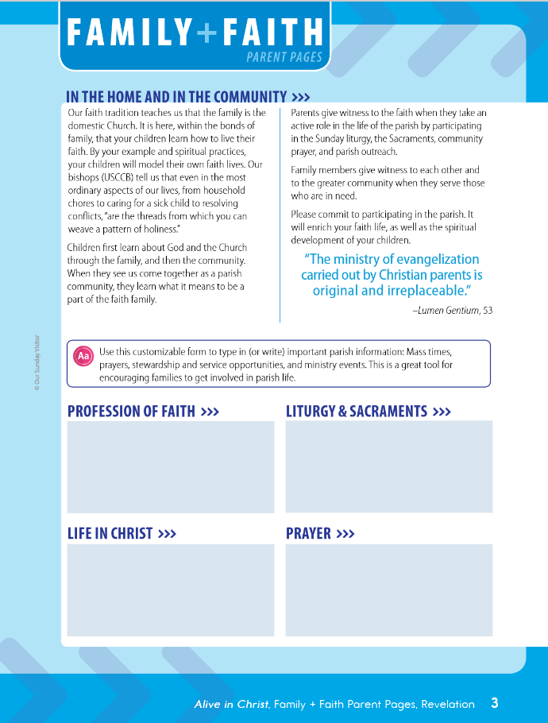
Domestic Church
Parish Church
Notes:
Review Key Features of the Family + Faith Parent Pages:
- In The Home and In the Community,
- Explains Domestic Church

Slide 34
Closing Prayer
Let us pray the Lord’s Prayer together, and then close with an intercession to Saint Francis. Together we pray:
“In the name of the Father, the Son, and the Holy Spirit. Amen “
“Our Father … deliver us from evil. Amen”
Saint Francis, pray for us. Amen.
Notes:
Call on the group to pray the Lord’s Prayer together, and then close with an intercession to Saint Francis.
Together we pray: “In the name of the Father, the Son, and the Holy Spirit. Amen”
“Our Father … deliver us from evil. Amen”
“Saint Francis, pray for us. Amen.”

